Slide 1


The best neighbourhood for an Indian restaurant to visit in New York
IBM Capstone Project: Applied Data Science Capstone
By Krishna Kantwala
Nov 2020

Slide 2
Main goal is to find is to find Indian restaurants which provide the best taste in the New York neighbourhood area.
Main Goal

Slide 3
List and visualize all major parts of New York City that has great Indian restaurants
What is best location in New York City for Indian Cuisine?
Which areas have potential Indian Restaurant Market?
Which all areas lack Indian Restaurants?
Which is the best place to stay if you prefer Indian Cuisine?
Problem statement

Slide 4



Data sources
Foursquare API
https://ru.foursquare.com/
The New York Datastore
https://cocl.us/new_york_dataset
Geo Space Data
https://data.cityofnewyork.us/City-
Government/Borough-Boundaries/tqmj-j8zm

Slide 5
Begin by collecting the New York city data
Find all venues for each neighbourhood using Foursquare API.
Filter out all venues with Indian restaurant for further analysis.
Find the Ratings, Tips, and Number of Likes for all the Indian Restaurants.
Sort Neighbourhoods and Borough the data keeping Ratings as the constraint.
consider all the neighbourhoods with average rating greater or equal 9.0 to visualize on map.
Finally, visualize the Neighbourhoods and Borough based on average rating.
Methodology:

Slide 6
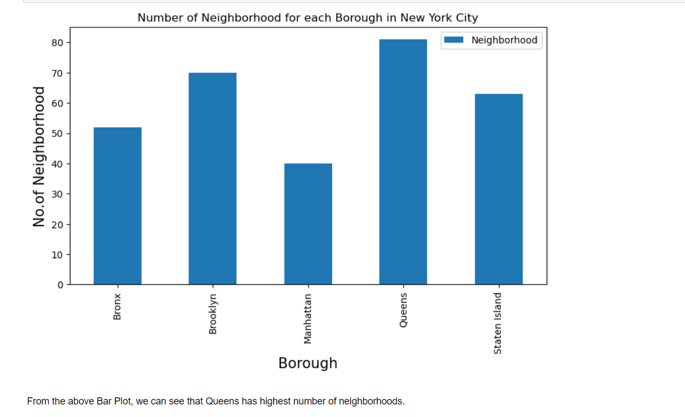
All venues for each neighborhood
Queens has the highest number of neighborhood.

Slide 7
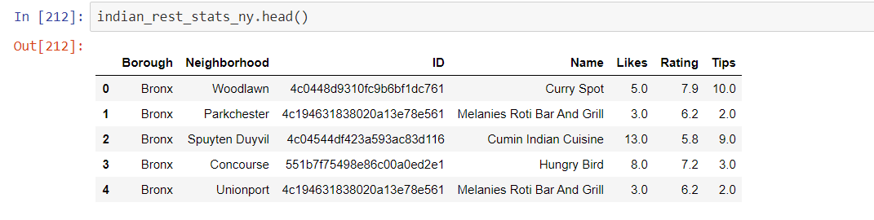
Ratings, Tips, and Number of Likes for all the Indian Restaurants.

Slide 8
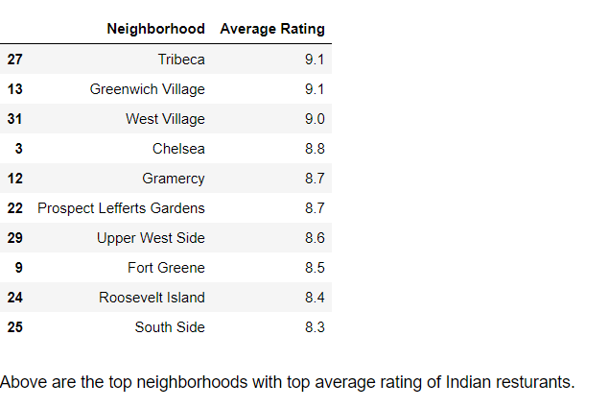
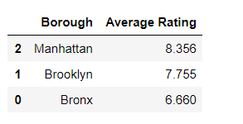
Top neighborhood and Borough with top average rating of Indian restaurants.

Slide 9
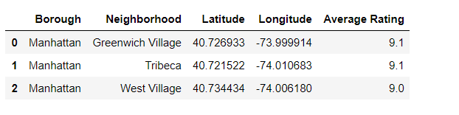
All the neighbourhoods with average rating greater or equal 9.0

Slide 10
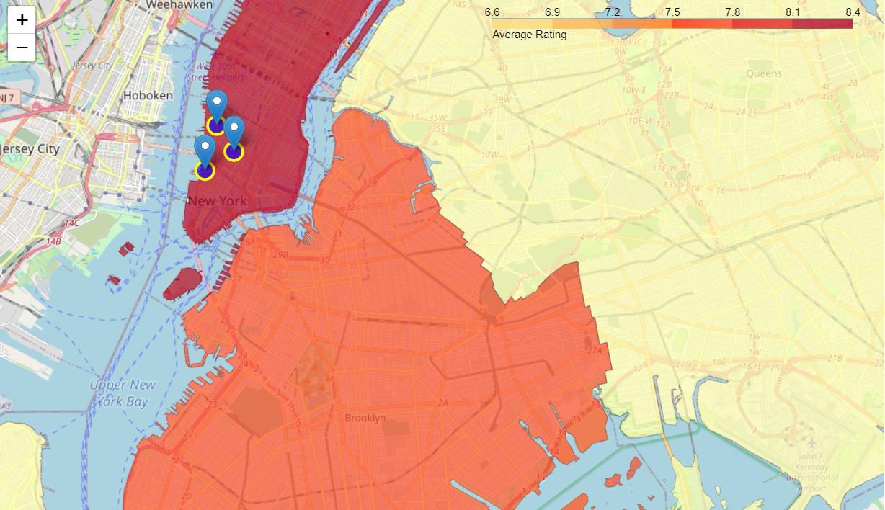
Neighbourhoods based on average Rating

Slide 11
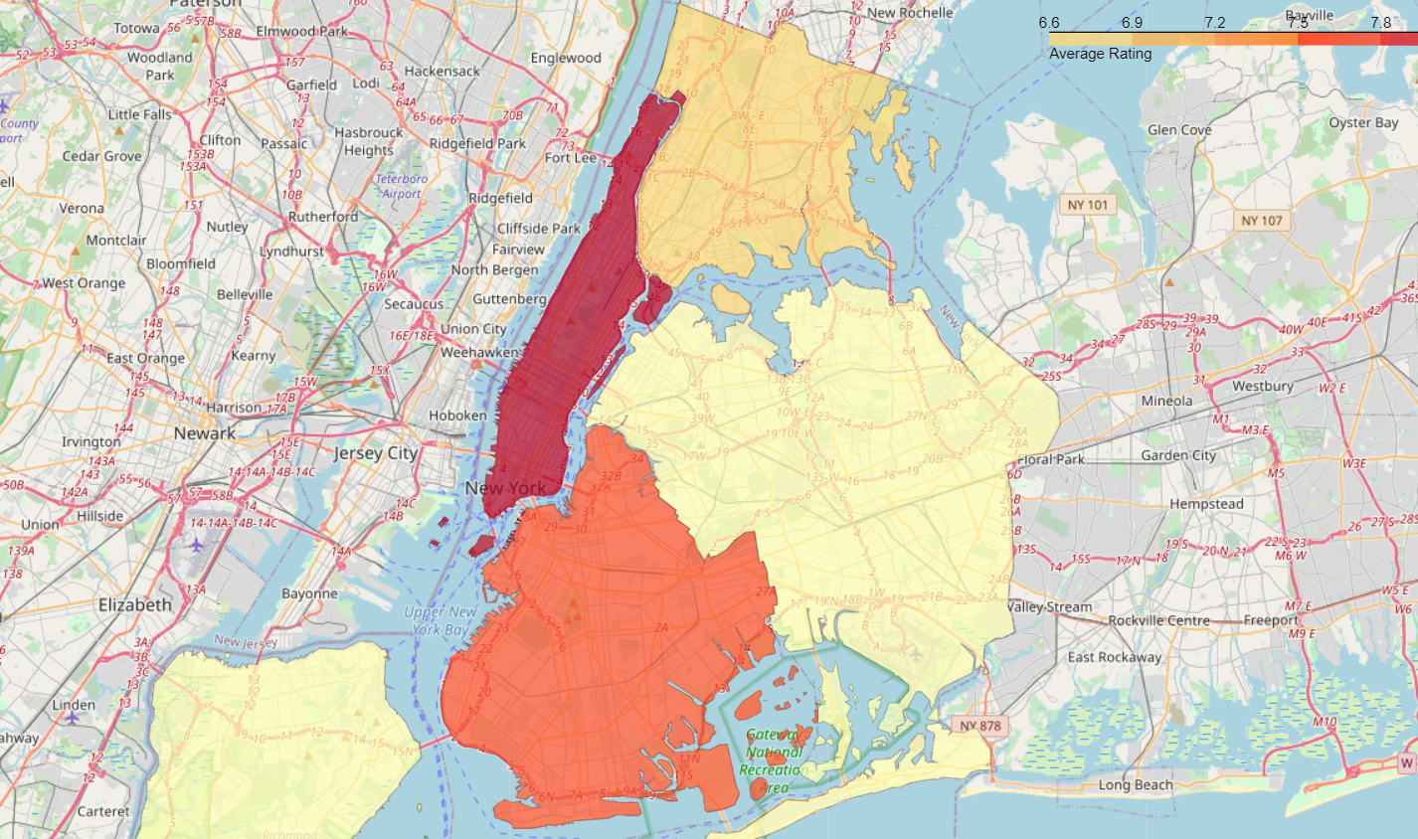
Borough based on average Rating

Slide 12
Results
Greenwich Village (Manhattan), Tribeca (Manhattan), West Village (Manhattan) are some of the best neighborhoods for Indian cuisine.
Manhattan have potential Indian Restaurant Market.
Bronx ranks last in average rating of Indian Restaurants.
Manhattan is the best place to stay if you prefer Indian Cuisine.

Slide 13

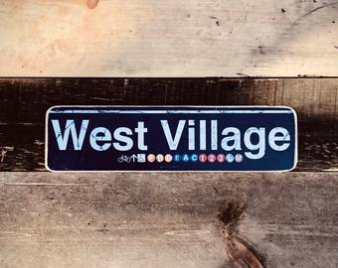

Conclusions
The best neighborhood for the Indian restaurants are:

